Slide 1

Comparing object representations in the brain and CNNs
Pod: Opisthocoelicaudia_Jook TA: Sarthak Sharma
Project TA: Mina Rezaie Mentor: Hazrat Ali
Group: FMRT Farnaz, Medha, Reza, Taraneh

Slide 2
Introduction
Comparing and bridging object representations in the brain and NNs
Classification of stimuli labels from neural responses
  To understand object representations in the brain
Fine tuning AlexNet on fMRI responses
  To improve similarity of object representations between the brain and AlexNet
Notes:
In this study, we aim to understand how the brain represents features and to use this knowledge to train networks that have more similar representations to the brain.
So in the first part of the project, we train a network to classify images from the neural responses evoked by them. Decoding brain activity this way can help us understand how the brain represents information.
In the second part, we use brain activity to fine tune a CNN - AlexNet and test whether this can make the CNN’s representations more similar to the brain.

Slide 3
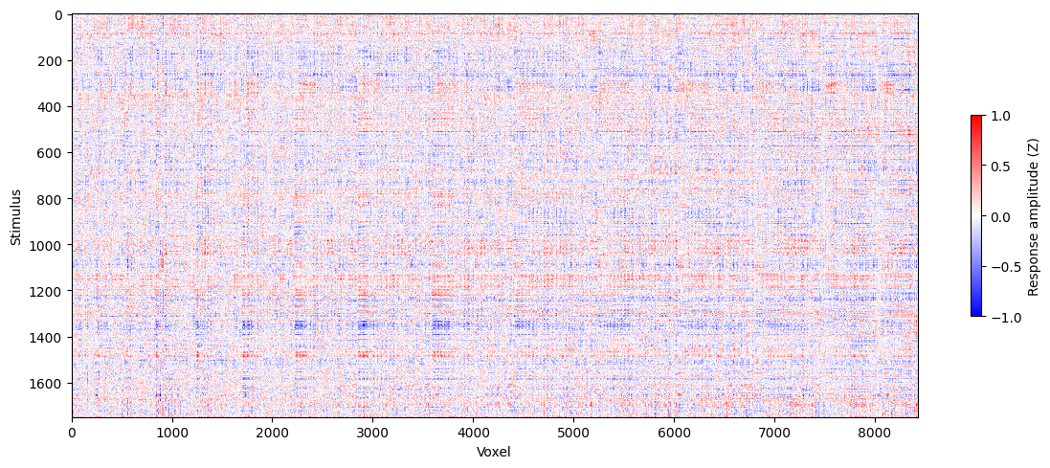
Dataset: Kay fMRI images
fMRI responses to 1750 images were recorded
~8500 voxels from 7 visual areas (V1, V2, V3, V3a, V3b, V4, LOC)
Image are labelled: from general class labels (animal, artifact, fruit, etc) to specific labels (elephant, clothes, apple, etc)
Notes:
The dataset consistent of fMRI responses to 1750 images. The responses were recorded from 8500 voxels taken from 7 visual areas in the brain - V1, V2,...LOC. In the plot, each row shows the response generated by 1 image from all the 8500 voxels.
The dataset also contained labels for each image. These labels were generated by a DNN pretrained on ImageNet. Each image could be labelled according to 4 different levels going from general classes (such as animal, fruit, artifact) to very specific labels (such as elephant, apple, clothes).

Slide 4
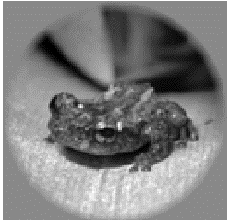
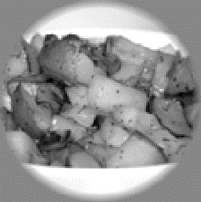
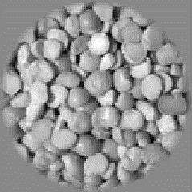
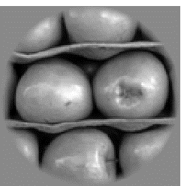
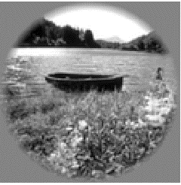
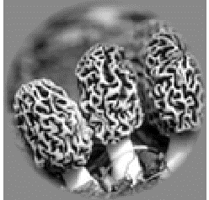
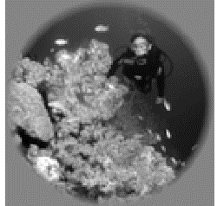
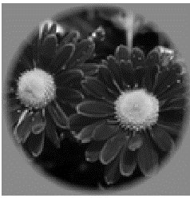
Example stimuli images from every general class
Animal
Entity
Artifact
Fruit
Geological Formation
Fungus
Person
Plant
Notes:
There were 8 general class labels.
These are some example stimuli from each general class label.

Slide 5
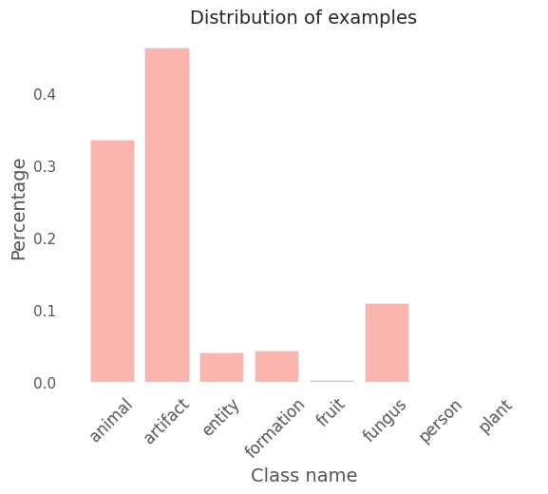
Class imbalance in the training dataset
Severely imbalanced dataset: 2 classes made up >75% of the examples
Weighted loss function and weighted resampling did not improve accuracy.
So we trained the network on the two most abundant classes with equal # of examples
Notes:
We found that the dataset was very imbalanced. As you can see from the plots, two classes - animal and artifact constituted more than 75% of all training labels.
Methods to handle imbalanced datasets such as weighted loss fn and resampling did not improve accuracy so we decided to include on the two most abundant classes with equal no, of examples from each class.

Slide 6
Network
4-Layer MLP
Voxel responses
MLP
Image labels
Training schedule:
Hidden layers consisted of 512, 256, 128, 64 units
30 epochs
Binary cross-entropy loss
L2 regularization
LR = 0.0001
Notes:
In our first model We followed a specific training schedule for our 4-layer MLP network for classifying images based on their fMRI responses. The hidden layers were structured with 512, 256, 128, and 64 units, respectively.
The training process was conducted for 30 epochs, utilizing binary cross-entropy loss (BCE) and L2 regularization.
The learning rate (LR) used during training was set to 0.0001. This schedule helped us achieve effective training and classification results for our MLP architecture.

Slide 7
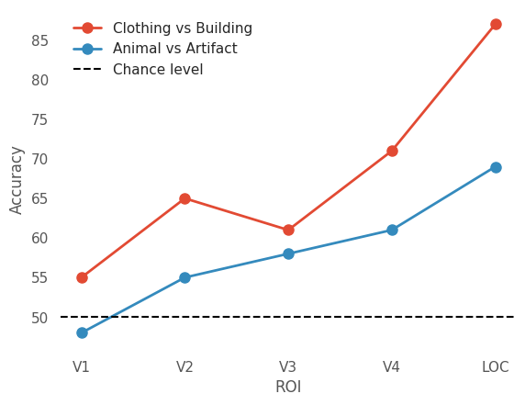
Classification accuracy for different ROIs
General labels: Animal vs Artifact
Performance increased from lower to higher visual areas.
Maximum accuracy of 70% for LOC.
Chance level
Notes:
In our initial phase of experimentation, we trained the network to perform image classification into two distinct labels: 'animals' and 'artifacts.' This classification was based on voxel responses gathered from 5 visual areas: V1, V2, V3, V5 and LOC.
As you can see in the plot, we observed a notable increase in network performance as we moved from lower areas to higher visual areas of brain. Remarkably, the network achieved its peak performance (70% accuracy) when using voxels from the LOC area.

Slide 8
Classification accuracy for different ROIs
Specific labels: Clothing vs building
Maximum accuracy of 87% for LOC.
Performance improves for specific labels
Neural activity in LOC likely to contain specific (rather than general) object representations
Specific labels easier to learn but also contain fewer examples
Chance level
Notes:
Next, we proceeded to examine the network's capability to classify more detailed examples. So, we trained our model to classify images by analyzing voxel responses related to distinguishing clothes from buildings. And, the network demonstrated significantly improved performance compared to our previous attempts with general labels.
This outcome isn't entirely unexpected since learning from specific examples is generally easier. This finding supports the fact that the LOC (lateral occipital complex) likely contains representations of specific objects rather than more general ones.

Slide 9
Fine-Tuning AlexNet on fMRI responses
Original AlexNet
Stimuli Images
AlexNet
Train Network = False
Image labels
Fine-tuned AlexNet
Neural Responses from LOC
Stimuli Images
AlexNet
Train Network = True
We compare feature representations between AlexNet & fMRI data from V1, V2, V4 & LOC
Notes:
In the second part of the project, we looked at whether fine-tuning a network based on neural activity from LOC can help the network learn representations that are more similar to the brain.
As a baseline for comparisons, we chose a pre-trained AlexNet which predicted class labels from images.
For our main model, we fine-tuned an AlexNet to predict fMRI responses from LOC from images. We then compared the feature representations between the fine-tuned Alex net and fMRI data from different visual regions. We expect that the AlexNet fine-tuned on LOC will learn feature representations that are more similar to the neural data.

Slide 10
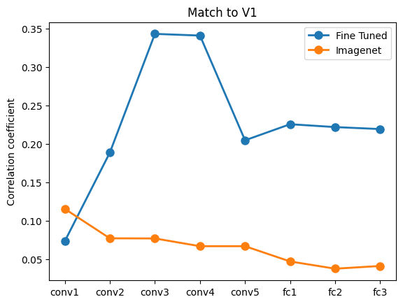
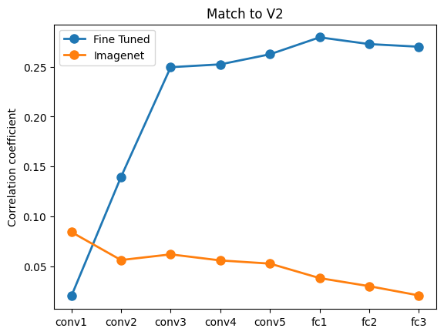
Fine-Tuning Results
Notes:
Results num_epochs = 300 learning_rate = 0.05

Slide 11
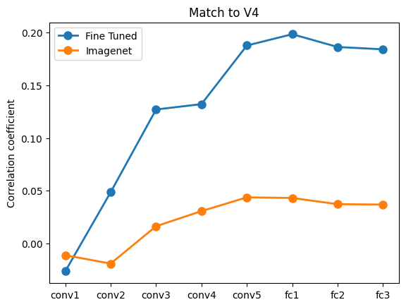
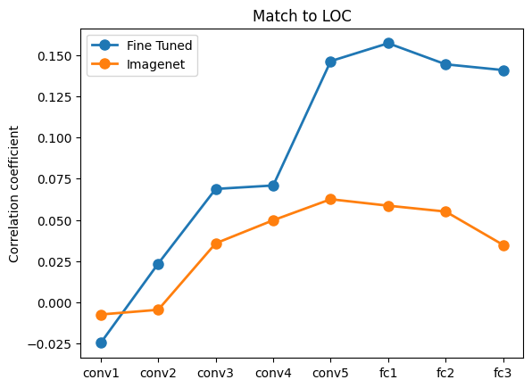
Fine-Tuning Results

Slide 12
Future work
Increasing the quality of stimuli
Using a more complicated model e.g Resnet
Using only images of classes clothing and building for fine-tuning
Trying to reconstruct the stimulus
Representational similarity analysis to compare representations

Slide 13
Thank You !

